Slide 1
Directional Analytics for Day Trading in Stock Market
REVA Academy for Corporate Excellence (RACE)
Anand Mohan
SRN: R19MBA53
Date: 10/10/2022
MBA in Business Analytics
Capstone Project Presentation
Year: II
race.reva.edu.in

Slide 2
Agenda
01
09
Descriptive Analytics
Introduction
05
Project Methodology
Conceptual Framework | Research Design
Univariate | Bivariate | Hypothesis
Back Ground | Current status | Why this study
10
Modeling
02
06
Literature Review
Business Understanding
Machine Learning | Model Evaluation | Insights
Seminal works | Summary | Research Gap
Business Context | Monetary Impact
11
Model Deployment
03
07
Data Understanding
Applications | Demo
Problem Statement
Business Problem | Analytics Solution
Data Collection | Variables
12
Suggestions and Conclusions
Insights | Next Step \| Future Scope
04
08
Data Preparation
Project Objectives
Primary & Secondary Objectives | Expected Outcome
Pre-processing | Process \| Techniques
13
Annexure
References | Publications | Plagiarism Score

Slide 3

Introduction
Background | Current status | Why this study
Algorithmic Trading
Back testing
Stock Market-high volatility-New field for Researchers!
ML, AML, Deep Learning Algorithms .
Higher Accuracy.
Minimize Errors.
ML Algorithms rank on relative expected outcome.

Slide 4
Literature Review
Paper Title | Authors | Journal | Objective | Research Gap (if any)
Stock Market Price Prediction and Analysis | Rajkar, Ajinkya, Aayush, Aniket | Inter national Journal of Engineering Research & Technology | Predict Stock market Returns using ML | Feature expansion and elimination techniques in data preparation lacking details
Analysis and Evaluation of Technical Indicators for Prediction of Stock Market | Thanekar, Gananjay Sandeep Zaheed Shamsuddin | International Journal of Engineering Research & Technology (IJERT) | Utilize Technical Indicator for higher SM Returns | Fundamental analysis should also be explored.
Effects of Volatility and Trend Indicator for Improving Price Prediction of Cryptocurrency | Dahham, Ibrahim, Abdullahi | IOP Conference Series: Materials Science and Engineering | Volatility and Trend Indicator for Predicting ret from Cryptocurrency. | Volume and momentum indicators also should be explored.

Slide 5
Literature Review
Seminal works | Summary | Research Gap
Paper Title | Authors | Journal | Objective | Research Gap (if any)
The random forest algorithm for statistical learning | Schonlau,Matthias Zou, Rosie Yuyan | Stata Journal | Classification and regression modelling using Random forest | Hyperparameters tuning to be explored further to improve prediction accuracy.
A systematic methodology to evaluate prediction models for driving classification | Silva, Iván Naranjo, José Eugenio | Sensors (Switzerland) | Evaluating classifiers using ML metrics (e.g., accuracy, F1-score)explored. | Evaluation metrics on robustness, scalability, speed should also be explored.
Combining Supervised and Unsupervised Machine Learning Methods for Phenotypic Functional Genomics Screening | Omta, Wienand, Matthieu, David A. | SLAS Dis covery | Unsupervised exploratory methods applied before modelling using supervised deep learning techniques. | Extensive research for quality of the training sets used and the quantity of available data in each training class in data understanding phase could be better.

Slide 6

Problem Statement
Business Problem | Analytics Solution
Easy, and simple Modelling techniques
Minimize losses
Fundamental Analysis-
Long Term Investments
Technical Analysis-trends in the stock's price, momentum, and volume
Algorithmic trading
Volatility Still Unpredictable

Slide 7


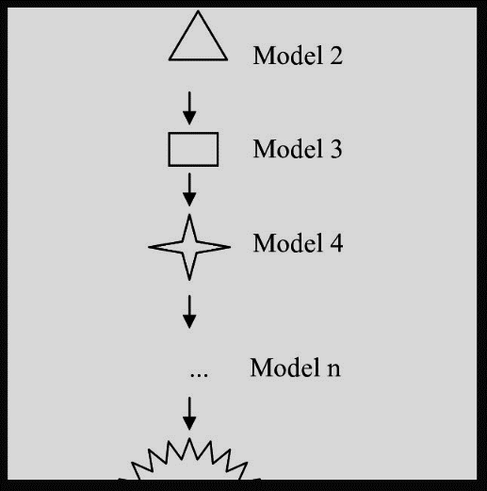
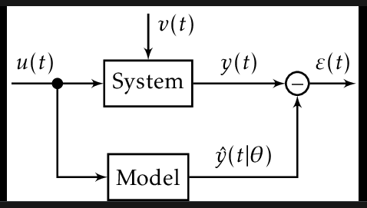

Project Objectives
EDA
Hypothesis Testing
Feature Addition
Get Right Stock
Collect Relevant data
Minimize prediction errors.
standard Error Metrics
Precision, recall,f1-score,
accuracy score, ROC AUC Score
Logistic Regression
Decision Tree
Random Forest
k-Nearest Neighbours
Extreme Gradient Boosting

Slide 8

Project Methodology

Slide 9
Business Understanding
HDFC Stock Technical Analysis
RSI is indicating that HDFC stock is moving in an upward trend.
ADX- 11.43
HDFC stock ADX is quite less meaning it will show a weak upward or downward trend.
RSI-58.72
Moving Average Convergence Divergence is indicating that HDFC stock is showing an upward trend.
ADX-Upper Band
1514.69
MACD - 18.97
close price of HDFC stock is 1493.05 which means HDFC stock is showing a sideways trend.
Stochastic89.62
Caution: HDFC stock is overbought and hence the investor should wait for some time so that the Stochastic indicator gives a lesser value.
ADX-Lower Band
1261.46

Slide 10
Business Understanding
HDFC Stock Fundamental Analysis
PARTICULARS | JUN 2021 | SEP 2021 | DEC 2021 | MAR 2022 | JUN 2022
Quarterly Result (All Figures in Cr.)
Net Profit | 7,729.64 | 8,834.31 | 10,342.20 | 10,055.18 | 9,195.99
Promoters Details
Promoters | 25.89 | 25.83 | 25.80 | 25.78 | 25.73
Investors Details
Investors | 74.11 | 74.17 | 74.20 | 74.22 | 74.27
PARTICULARS | MAR 2018 | MAR 2019 | MAR 2020 | MAR 2021 | MAR 2022
Profit & Loss (All Figures in Cr. Adjusted EPS in Rs.)
Net Profit | 17,486.73 | 21,078.17 | 26,257.32 | 31,116.53 | 36,961.36
Adjusted EPS (Rs.) | 33.69 | 38.70 | 47.89 | 56.44 | 66.65
Balance Sheet (All Figures are in Crores.)
Total Liabilities | 10,63,934.32 | 12,44,540.69 | 15,30,511.26 | 17,46,870.52 | 20,68,535.05
Total Assets | 10,63,934.32 | 12,44,540.69 | 15,30,511.26 | 17,46,870.52 | 20,68,535.05
Cashflow (All Figures are in Crores.)
Closing Cash | 123,062 | 81,818 | 87,940 | 121,273 | 155,386

Slide 11
Business Understanding
KOTAK Stock Technical Analysis
RSI is indicating that KOTAK stock is moving in an upward trend.
ADX- 37.66
KOTAK stock ADX is quite less meaning it will show a strong upward or downward trend.
RSI-60.33
Moving Average Convergence Divergence is indicating that KOTAK stock is showing an upward trend.
ADX-Upper Band
1970.16
MACD 25.42
close price of KOTAK stock is 1944.20 which means KOTAK stock is showing a sideways trend but may soon show upward trend.
Stochastic76.32
Stochastic is indicating that KOTAK stock is showing an upward trend.
ADX-Lower Band
1854.60

Slide 12
Business Understanding
KOTAK Stock Fundamental Analysis
PARTICULARS | JUN 2021 | SEP 2021 | DEC 2021 | MAR 2022 | JUN 2022
Quarterly Result (All Figures in Cr.)
Net Profit | 1,641.92 | 2,032.01 | 2,131.36 | 2,767.40 | 2,071.15
Promoters Details
Promoters | 26.00 | 26.00 | 25.99 | 25.98 | 25.97
Investors Details
Investors | 74.00 | 74.00 | 74.01 | 74.02 | 74.03
PARTICULARS | MAR 2018 | MAR 2019 | MAR 2020 | MAR 2021 | MAR 2022
Profit & Loss (All Figures in Cr. Adjusted EPS in Rs.)
Net Profit | 4,084.30 | 4,865.33 | 5,947.18 | 6,964.84 | 8,572.69
Adjusted EPS (Rs.) | 21.43 | 25.49 | 30.88 | 34.94 | 42.99
Balance Sheet (All Figures are in Crores.)
Total Liabilities | 2,64,933.40 | 3,12,172.09 | 3,60,251.68 | 3,83,470.16 | 4,29,428.40
Total Assets | 2,64,933.40 | 3,12,172.09 | 3,60,251.68 | 3,83,470.16 | 4,29,428.40
Cashflow (All Figures are in Crores.)
Closing Cash | 24,401 | 31,264 | 64,080 | 47,717 | 52,665

Slide 13
Business Understanding
SBI Stock Technical Analysis
RSI is indicating that SBI stock is moving in an upward trend.
ADX- 30.53
RSI-69.86
SBI stock ADX is quite less meaning it will show a strong upward or downward trend.
Moving Average Convergence Divergence is indicating that SBI stock is showing an upward trend.
ADX-Upper Band
582.40
MACD 14.07
close price of SBI stock is 575.05 which means SBI stock is showing a sideways trend but may soon show upward trend.
Stochastic95.02
Caution: SBI stock is overbought and hence the investor should wait for some time so that the Stochastic indicator gives a lesser value.
ADX-Lower Band
505.09

Slide 14
Business Understanding
SBI Stock Fundamental Analysis
PARTICULARS | JUN 2021 | SEP 2021 | DEC 2021 | MAR 2022 | JUN 2022
Quarterly Result (All Figures in Cr.)
Net Profit | 6,504 | 7,626.57 | 8,431.88 | 9,113.53 | 6,068.08
Promoters Details
Promoters | 57.62% | 57.62% | 57.60% | 57.59% | 57.57%
Investors Details
Investors | 42.38% | 42.38% | 42.40% | 42.41% | 42.43%
PARTICULARS | MAR 2018 | MAR 2019 | MAR 2020 | MAR 2021 | MAR 2022
Profit & Loss (All Figures in Cr. Adjusted EPS in Rs.)
Net Profit | -6,547.45 | 862.23 | 14,488.11 | 20,410.47 | 31,675.98
Adjusted EPS (Rs.) | -7.34 | 0.97 | 16.23 | 22.87 | 35.49
Balance Sheet (All Figures are in Crores.)
Total Liabilities | 34,54,752 | 36,80,914.25 | 39,51,393.92 | 45,34,429.63 | 49,87,597.41
Total Assets | 34,54,752 | 36,80,914.25 | 39,51,393.92 | 45,34,429.63 | 49,87,597.41
Cashflow (All Figures are in Crores.)
Closing Cash | 195,289 | 225,512 | 254,315 | 347,707 | 398,905

Slide 15
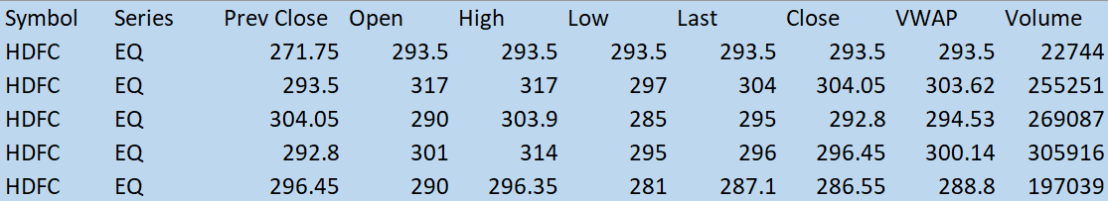
Data Understanding
The previous close nearly always refers to the previous day's final price.
The opening price is the first trade price that was recorded.
The high is the highest price at that a stock is listed during a period.
The low is the lowest price of the period
The last price is the one at which the foremost recent transaction happens.
The close is the last price once the market is closed on the day.
volume-weighted average worth (VWAP) represents the typical price listed throughout the day, based on both volume and worth.
Volume and Share turnover is an estimation of stock liquidity.

Slide 16
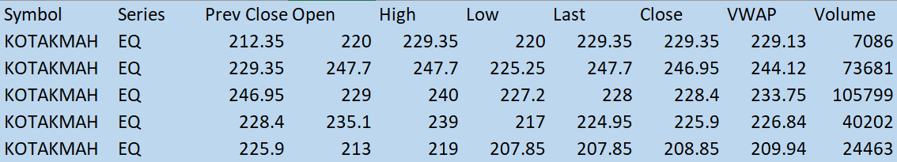
Data Understanding
The previous close nearly always refers to the previous day's final price.
The opening price is the first trade price that was recorded.
The high is the highest price at that a stock is listed during a period.
The low is the lowest price of the period
The last price is the one at which the foremost recent transaction happens.
The close is the last price once the market is closed on the day.
volume-weighted average worth (VWAP) represents the typical price listed throughout the day, based on both volume and worth.
Volume and Share turnover is an estimation of stock liquidity.

Slide 17
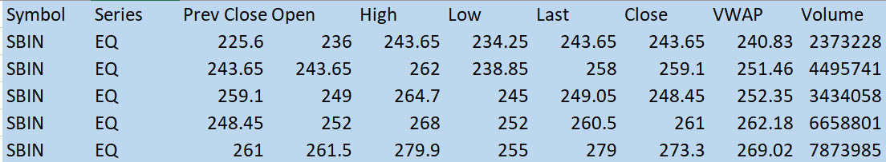
Data Understanding
The previous close nearly always refers to the previous day's final price.
The opening price is the first trade price that was recorded.
The high is the highest price at that a stock is listed during a period.
The low is the lowest price of the period
The last price is the one at which the foremost recent transaction happens.
The close is the last price once the market is closed on the day.
volume-weighted average worth (VWAP) represents the typical price listed throughout the day, based on both volume and worth.
Volume and Share turnover is an estimation of stock liquidity.

Slide 18



Data Preparation
'Trades', 'Deliverable Volume', and'% Deliverable' had more than 100 missing values. Hence, those columns were dropped.
13 days,20 days,100 days, 200 days Simple moving averages were added in the data frame. conjointly enclosed were exponential moving averages for 7 days,13 days,20 days,100 days, and 200 days.1 day's previous lag values of volume is also added in as derived features.
6,10,14 and 30 days consecutive closing prices are tabulated week on week for the entire dataset and utilized as different feature variables for building the classification Models. Momentum, trend, volatility, volume indicators were added as feature variables.
MinMax Scaler shrinks the data inside the given range in this project i.e. from zero to one. It scales the price to a selected value range while not varying the form of the initial distribution.

Slide 19
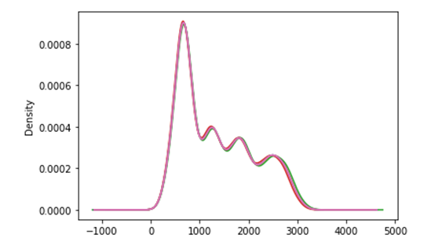
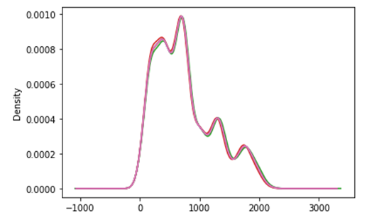
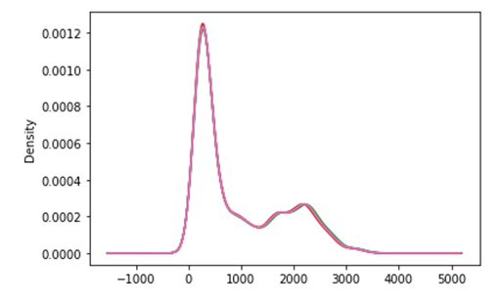
Descriptive Analytics
Data Distribution plot of Feature variables and Close price for HDFC Stock shows Data has positive skewed distribution.
Data Distribution plot of Feature variables and Close price for KOTAK Stock shows Data has positive skewed distribution.
Data Distribution plot of Feature variables and Close price for SBI Stock shows Data has positive skewed distribution.

Slide 20
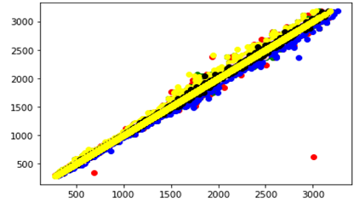
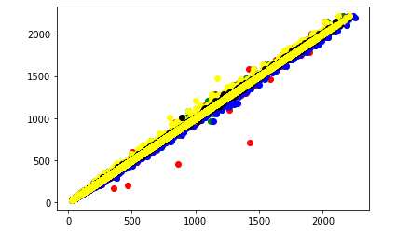
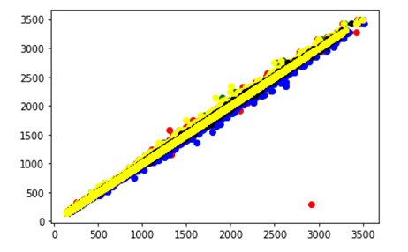
Descriptive Analytics
Scatter plot of Feature variables and Close price for HDFC Stock
Scatter plot of Feature variables and Close price for KOTAK Stock
Scatter plot of Feature variables and Close price for SBI Stock

Slide 21




Modeling
Modeling Techniques | Modeling Process | Model Building
Feature Engineering CLOSE PRICE
Direction Detection by 6,10,14 days consecutive closing prices split
week on week
Go Long and Go Short Direction Prediction using Momentum Indicators as Feature Variables on 0.5% percentage change of the closing price
Go Long and Go Short Direction Prediction using Trend Indicators as Feature Variables on 0.5% percentage change of the closing price
Go Long and Go Short Direction Prediction using volatility Indicators as Feature Variables on 0.5% percentage change of the closing price
Go Long and Go Short Direction Prediction using Volume Indicators as Feature Variables on 0.5% percentage change of the closing price

Slide 22
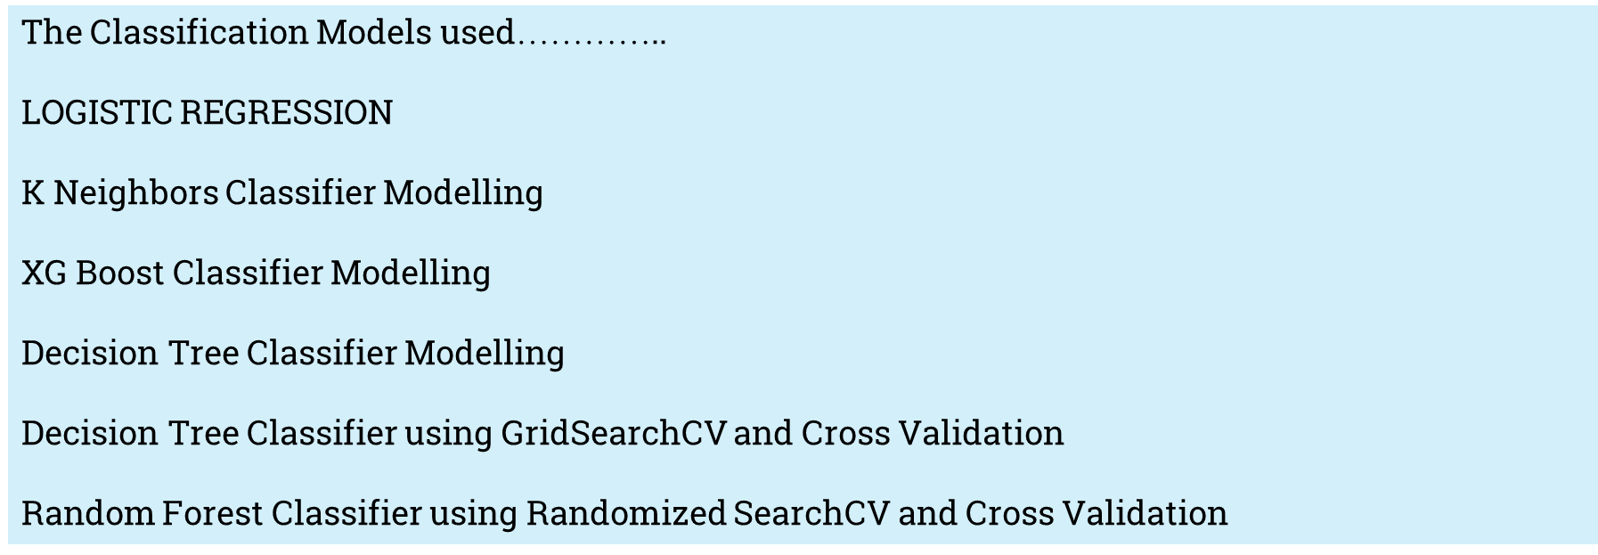
Modeling
Modeling Techniques | Modeling Process | Model Building

Slide 23
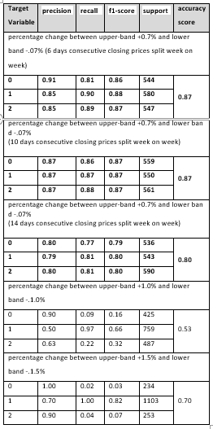
Model Evaluation
Results | Interpretation | Insights
Direction Detection by 6,10,14 days consecutive closing prices split week on week:
RF has given the highest efficiency in prediction among all Modelling techniques.
It predicts upward, neutral and downward trend direction with reasonably good precision.
F1-score combining the precision and recall of a classifier into a single metric is also reasonably good.
This has been tested and proven with 6,10 and 14-days consecutive closing prices split week on week as 6,10 and 14 feature variables.

Slide 24
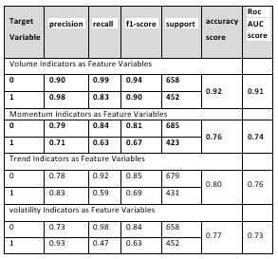
Model Evaluation
Results | Interpretation | Insights
Go Long Direction Prediction using Technical Indicators
LR has given considerably good accuracy score.
Precision and f1-score are also satisfactory.
Recall can be improved further for trend and volatility indicators.
ROC AUC score has been considerably satisfactory.

Slide 25
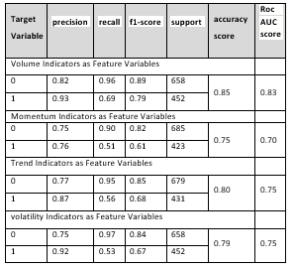
Model Evaluation
Results | Interpretation | Insights
Go Long Direction Prediction using Technical Indicators
RF has given considerably good accuracy score.
Recall and accuracy can be improved further for all especially for predicting upward direction trend.
ROC AUC score has been considerably satisfactory for all technical indicators.

Slide 26
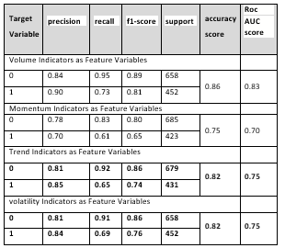
Model Evaluation
Results | Interpretation | Insights
Go Long Direction Prediction using Technical Indicators
XG Boost has given considerably good accuracy score.
Precision and f1-score are also satisfactory.
Recall can be improved further for momentum, trend and volatility indicators.
ROC AUC score has been considerably satisfactory.

Slide 27
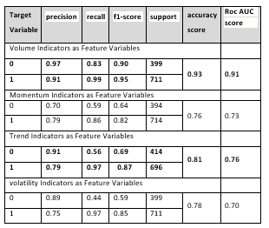
Model Evaluation
Results | Interpretation | Insights
Go Short Direction Prediction using Technical Indicators
LR has given considerably good accuracy score.
Precision and f1-score are also satisfactory.
Recall can be improved further for trend indicators.
ROC AUC score has been considerably satisfactory.

Slide 28
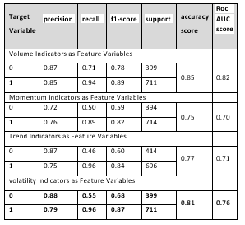
Model Evaluation
Results | Interpretation | Insights
Go Short Direction Prediction using Technical Indicators
RF has given considerably good accuracy score.
Recall and accuracy can be improved further for all especially for recalling downward direction trend.
ROC AUC score has been considerably satisfactory.

Slide 29
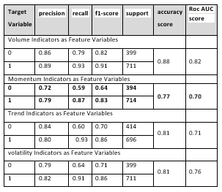
Model Evaluation
Results | Interpretation | Insights
Go Short Direction Prediction using Technical Indicators
XG Boost has given considerably good accuracy score.
Precision and f1-score are also satisfactory.
Recall can be improved further for recalling downward trend direction.
ROC AUC score has been considerably satisfactory for all technical indicators.

Slide 30


Model Deployment
Demonstration
As per the proposal for future assignments, the dashboard takes API as an input Derived from the machine/deep learning algorithms for multi-label features with an end-to-end UI Interface.

Slide 31
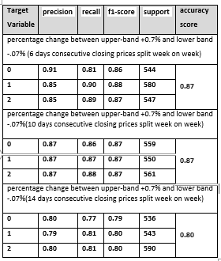
Results and Insights
Key Findings | Suggestions
RECOMMENDATION FROM BUSINESS PERSPECTIVE for the HDFC Stock:
Random Forest Modelling Predicts upward, neutral and downward trend direction with reasonably good precision,recall,F1-score.
overall accuracy score-more than 80%.
For a stop loss of 2.0 reward to risk ratio for RF would be 2*.87/2*.13=6.69:1 if 0.7% difference in consecutive day close price for HDFC stock is only 2.0.for higher percentage difference reward to risk ratio would be higher.

Slide 32
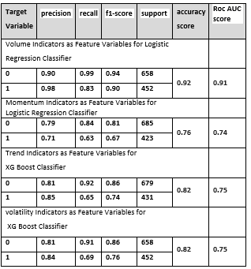
Results and Insights
Key Findings | Suggestions
RECOMMENDATION FROM BUSINESS PERSPECTIVE for the HDFC Stock:
Go Long Direction Prediction using Technical Indicators
LR has given highest precision, recall, f1-score and accuracy score for volume and momentum indicators.
XG Boost Classifier provided best prediction performance for trend and volatility indicators.
For a stop loss of 2.0 reward to risk ratio for LR would be 2*.92/2*.08=11.5:1 if 0.5% difference in consecutive day close price for HDFC stock is only 2.0.for higher percentage difference reward to risk ratio would be higher.

Slide 33
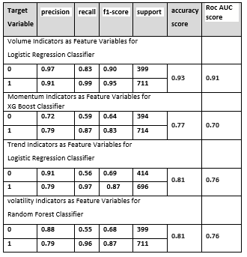
Results and Insights
Key Findings | Suggestions
RECOMMENDATION FROM BUSINESS PERSPECTIVE for the HDFC Stock:
Go Short Direction Prediction using Technical Indicators
LR has given highest precision, recall, f1-score and accuracy score for volume and trend indicators.
XG Boost Classifier provided best prediction performance for momentum indicators.
Random Forest Classifier provided best predictions for volatility indicators.
For a stop loss of 2.0 reward to risk ratio for LR would be 2*.93/2*.07=13.29:1 if 0.5% difference in consecutive day close price for HDFC stock is only 2.0.for higher percentage difference reward to risk ratio would be higher.

Slide 34

Conclusion and Future Work
Any stock on the stock market can utilize the same procedure as defined in this project to forecast buy or sell choices, which is helpful.
Intelligent Automated system on Options Trading would be the next step forward.
In the Future, there is a deployment Dashboard proposed.
In future projects, it can be shown how to define Bullish and Bearish regimes using modern machine learning techniques.
The Sentiment Analysis Approach may also be explored using Text Analytics for predicting stock market returns.

Slide 35
References
Bibliography | Webliography
Al-Bairmani, Z. A. A., & Ismael, A. A. (2021). Using Logistic Regression Model to Study the Most Important Factors Which Affects Diabetes for the Elderly in the City of Hilla / 2019. Journal of Physics: Conference Series, 1818(1). https://doi.org/10.1088/1742-6596/1818/1/012016
Alhomadi, A. (2021). Forecasting stock market prices : A machine learning approach. Digital Commons, 11(2), 16–36.
Anjani, T., & Syarif, A. D. (2019). The Effect of Fundamental Analysis on Stock Returns using Data Panels ; Evidence Pharmaceutical Companies listed on IDX. International Journal of Innovate Science and Research Technology, 4(7), 500–505.
Cornellius Yudha Wijaya. (2021). CRISP-DM Methodology For Your First Data Science Project. https://towardsdatascience.com/crisp-dm-methodology-for-your-first-data-science-project-769f35e0346c
Dahham, A. Z. D., & Ibrahim, A. A. (2020). Effects of Volatility and Trend Indicator for Improving Price Prediction of Cryptocurrency. IOP Conference Series: Materials Science and Engineering, 928(3). https://doi.org/10.1088/1757-899X/928/3/032043
Dar, A. N. (2021). PRINCIPAL COMPONENT ANALYSIS (PCA) (Using Eigen Decomposition). Gsj, 9(7), 240–252. www.globalscientificjournal.com
Elbialy, B. A. (2019). The Effect of Using Technical and Fundamental Analysis on the Effectiveness of Investment Decisions of Traders on the Egyptian Stock Exchange. International Journal of Applied Engineering Research, 14(24), 4492–4501. http://www.ripublication.com
Faijareon, C., & Sornil, O. (2019). Evolving and combining technical indicators to generate trading strategies. Journal of Physics: Conference Series, 1195(1). https://doi.org/10.1088/1742-6596/1195/1/012010
Hafeez, M. A., Rashid, M., Tariq, H., Abideen, Z. U., Alotaibi, S. S., & Sinky, M. H. (2021). Performance improvement of decision tree: A robust classifier using tabu search algorithm. Applied Sciences (Switzerland), 11(15). https://doi.org/10.3390/app11156728
Hansen, K. B. (2020). The virtue of simplicity: On machine learning models in algorithmic trading. Big Data and Society, 7(1). https://doi.org/10.1177/2053951720926558
Huang, Y., Capretz, L. F., & Ho, D. (2021). Machine Learning for Stock Prediction Based on Fundamental Analysis. 2021 IEEE Symposium Series on Computational Intelligence, SSCI

Slide 36
References
Bibliography | Webliography
2021 - Proceedings. https://doi.org/10.1109/SSCI50451.2021.9660134
Jena, M., & Dehuri, S. (2020). Decision tree for classification and regression: A state-of-the art review. Informatica (Slovenia), 44(4), 405–420. https://doi.org/10.31449/INF.V44I4.3023
Kimbonguila, A., Matos, L., Petit, J., Scher, J., & Nzikou, J.-M. (2019). Effect of Physical Treatment on the Physicochemical, Rheological and Functional Properties of Yam Meal of the Cultivar “Ngumvu” From Dioscorea Alata L. of Congo. International Journal of Recent Scientific Research, 10, 30693–30695. https://doi.org/10.24327/IJRSR
Magner, N., Lavin, J. F., Valle, M., & Hardy, N. (2021). The predictive power of stock market’s expectations volatility: A financial synchronization phenomenon. PLoS ONE, 16(5 May), 1–21. https://doi.org/10.1371/journal.pone.0250846
Markoulidakis, I., Kopsiaftis, G., Rallis, I., & Georgoulas, I. (2021). Multi-Class Confusion Matrix Reduction method and its application on Net Promoter Score classification problem. ACM International Conference Proceeding Series, 412–419. https://doi.org/10.1145/3453892.3461323
Mohapatra, S., & Misra, A. K. (2020). Momentum returns: A portfolio-based empirical study to establish evidence, factors and profitability in Indian stock market. IIMB Management Review, 32(1), 75–84. https://doi.org/10.1016/j.iimb.2019.07.007
moneycontrol. (n.d.). HDFC Bank Ltd.TECHNICALS. https://www.moneycontrol.com/technical-analysis/hdfcbank/HDF01/weekly
Mukerji, P., Chung, C., Walsh, T., & Xiong, B. (2019). The Impact of Algorithmic Trading in a Simulated Asset Market. Journal of Risk and Financial Management, 12(2), 68. https://doi.org/10.3390/jrfm12020068
Omta, W. A., van Heesbeen, R. G., Shen, I., de Nobel, J., Robers, D., van der Velden, L. M., Medema, R. H., Siebes, A. P. J. M., Feelders, A. J., Brinkkemper, S., Klumperman, J. S., Spruit, M. R., Brinkhuis, M. J. S., & Egan, D. A. (2020). Combining Supervised and Unsupervised Machine Learning Methods for Phenotypic Functional Genomics Screening. SLAS Discovery, 25(6), 655–664. https://doi.org/10.1177/2472555220919345
Rajkar, A., Kumaria, A., Raut, A., & Kulkarni, N. (2021). Stock Market Price Prediction and Analysis. International Journal of Engineering Research & Technology, 10(06), 115–119.
Rouf, N., Malik, M. B., Arif, T., Sharma, S., Singh, S., Aich, S., & Kim, H. C. (2021). Stock

Slide 37
References
Bibliography | Webliography
market prediction using machine learning techniques: A decade survey on methodologies, recent developments, and future directions. Electronics (Switzerland), 10(21). https://doi.org/10.3390/electronics10212717
Schonlau, M., & Zou, R. Y. (2020). The random forest algorithm for statistical learning. Stata Journal, 20(1), 3–29. https://doi.org/10.1177/1536867X20909688
Shah, D., Isah, H., & Zulkernine, F. (2019). Stock market analysis: A review and taxonomy of prediction techniques. International Journal of Financial Studies, 7(2). https://doi.org/10.3390/ijfs7020026
Silva, I., & Naranjo, J. E. (2020). A systematic methodology to evaluate prediction models for driving style classification. Sensors (Switzerland), 20(6), 1–21. https://doi.org/10.3390/s20061692
Sonkiya, P., Bajpai, V., & Bansal, A. (2021). Stock price prediction using BERT and GAN. http://arxiv.org/abs/2107.09055
Thanekar, G. S., & Shaikh, Z. S. (2021). Analysis and Evaluation of Technical Indicators for Prediction of Stock Market. International Journal of Engineering Research & Technology (IJERT), 10(May), 341–344.
Wang, L. (2019). Research and Implementation of Machine Learning Classifier Based on KNN. IOP Conference Series: Materials Science and Engineering, 677(5), 0–5. https://doi.org/10.1088/1757-899X/677/5/052038
Zhang, P., Jia, Y., & Shang, Y. (2022). Research and application of XGBoost in imbalanced data. International Journal of Distributed Sensor Networks, 18(6). https://doi.org/10.1177/15501329221106935

Slide 38
Annexure
Additional Information | Plagiarism score

Slide 39
Annexure
Publications | Conferences
The implementation for the capstone project can be accessed at the link below:
https://github.com/Embedded-org/ACCOMPLISHMENTS/tree/master/RACE_CAPSTONE_PROJECT2
The implementation document for the capstone project can be accessed at the link below:
https://github.com/Embedded-org/ACCOMPLISHMENTS/blob/master/RACE_CAPSTONE_PROJECT2/Capstone2_implementation.docx

Slide 40


